Slide 1
CUSTOMER CHURN PREDICTION IN TELECOMMUNICATION SECTOR
Dr. M. POONGOTHAI M.E.,Ph.D (PROJECT GUIDE)
PRITHIBHA V T (18IMT22)
RAAGAMAALIKA O R (18IMT23)
GOVERNMENT COLLEGE OF ENGINEERING,
ERODE.

Slide 2

TELECOM CUSTOMER CHURN ANALYSIS AND PREDICTION
INTRODUCTION
Churn prediction means detecting which customers are likely to leave a service or to cancel a subscription to a service.
It is a critical prediction for many businesses because acquiring new clients often costs more than retaining existing ones. Customer churn measures how and why are customers leaving the business.
Hence, the insights gained from Churn Prediction helps them to focus more on the customers that are at a high risk of leaving.
AIM: TO APPLY OUR CORE SUBJECTS (BIG DATA, NEURAL NETWORKS AND MUCH MORE) INTO A REAL WORLD USECASE(TELECOMMUNICATION SECTOR).

Slide 3
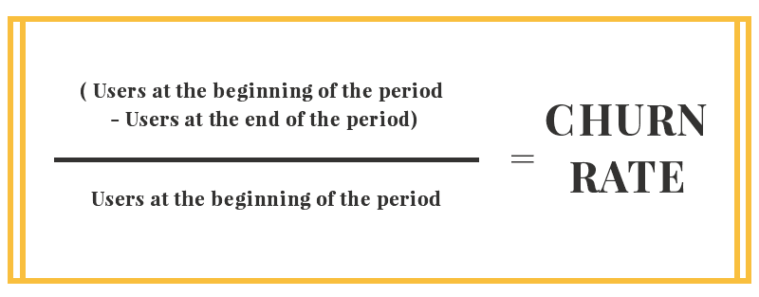
TELECOM CUSTOMER CHURN ANALYSIS AND PREDICTION
BACKGROUND AND MOTIVATION BEHIND THE STUDY
REASONS FOR CUSTOMER CHURN CAN BE VARIOUS AND THE MOST TYPICAL ARE :
Poor customer service,
Not finding enough value in a product or service,
Lack of customer loyalty and lack of communications.
MOTIVATIONAL ASPECT (CHURN RATE):
Churn is a good indicator of growth potential.
Churn rates track lost customers, and growth rates track new customers
If growth >> churn rate -- business is growing. If churn rate >> growth --business is getting smaller.
Churn tells you how many existing customers are leaving your business, so lowering churn has a big positive impact on your revenue streams.

Slide 4
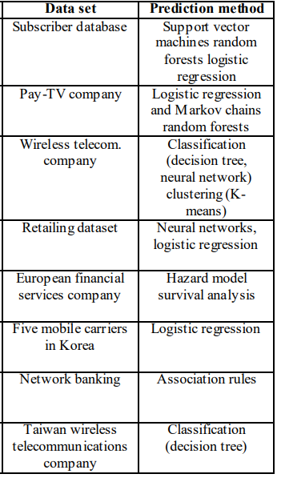
LITERATURE SURVEY
EXISTING SYSTEM
According to research literature about customer churn, most of the related work focuses on using only one data mining method such as classification or clustering to mine the customer retention data.
Few studies applied more than one technology which was based on cluster analysis and classification .
From the review of the literature we can conclude that neural network can predict customer churn in different domains like Pay-TV , retail, banking and finance.

Slide 5
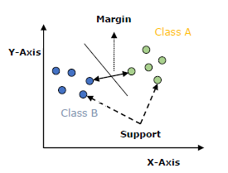
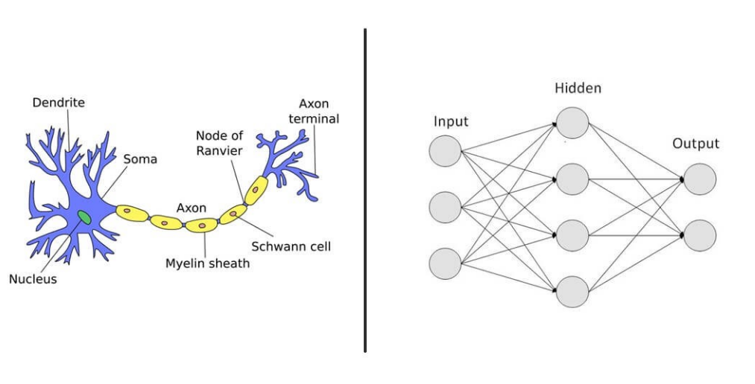
IMPLEMENTATION USING SUPPORT VECTOR MACHINE AND NEURAL NETWORKS
PROPOSED SYSTEM
Svm
Linear SVC
Gaussian-rbf SVC
Sigmoid SVC
Polynomial SVC and
Artificial Neural Networks

Slide 6
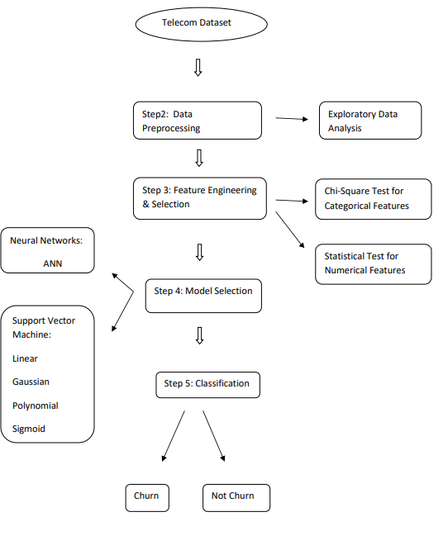
OUTLINE OF THE PROJECT
PROCESS-STACK OF THE PROJECT

Slide 7
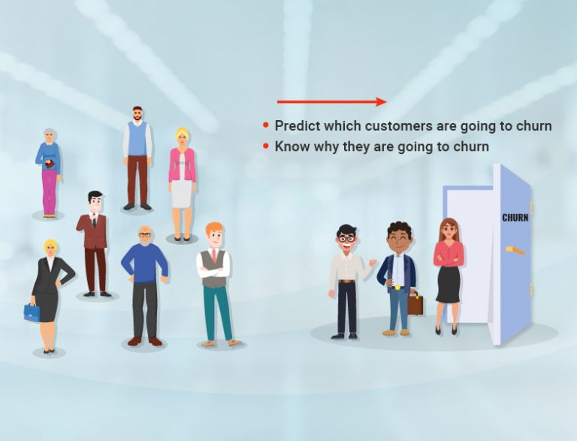
AIM OF THE PROJECT
WE AIM TO ACCOMPLISH THE FOLLOWING FOR THIS STUDY….
The objective is to predict to a high accuracy, in advance the customers who may attrite from the existing service provider in near future.
Identify and visualize which factors contribute to customer churn.
Build a prediction model that will perform the following :
Classify if a customer is going to churn or not.
2. based on model performance, choose a model that makes it easier for customer service to target.

Slide 8
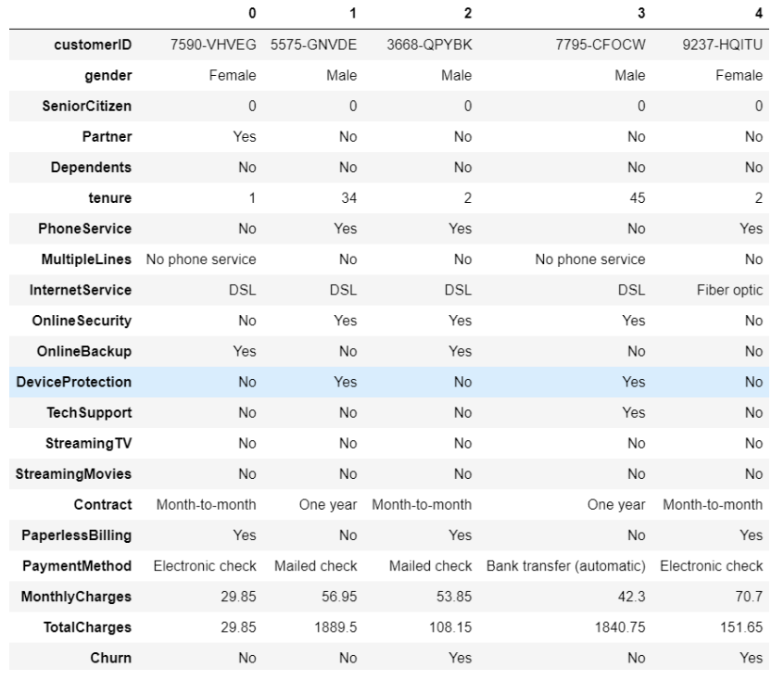
UNDERSTANDING OF THE DATASET
PHASE 1: DATA DESCRIPTION and EXPLORATION

Slide 9
EXPLORATORY DATA ANALYSIS
PHASE 1: INSIGHTS FROM EXPLORATORY DATA ANALYSIS (EDA)

Slide 10
FEATURE ENGINEERING
PHASE 2: DATA CLEANING , DATA PRE-PROCESSING AND FEATURE SELECTION

Slide 11
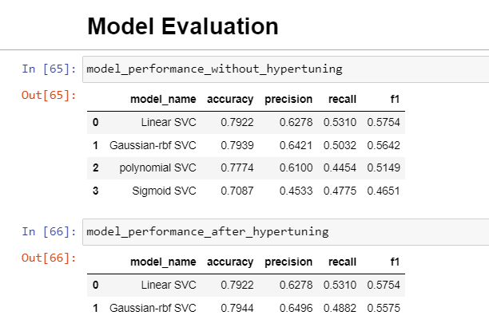
MODEL SELECTION AND TRAINING
PHASE 3: MODEL BUILDING USING SVM CLASSIFIERS

Slide 12
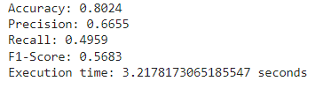
MODEL SELECTION AND TRAINING
.
G
PHASE 3: MODEL BUILDING USING ANN

Slide 13
MODEL SELECTION AND EVALUATION
.
G
PHASE 3: MODEL BUILDING USING AN

Slide 14
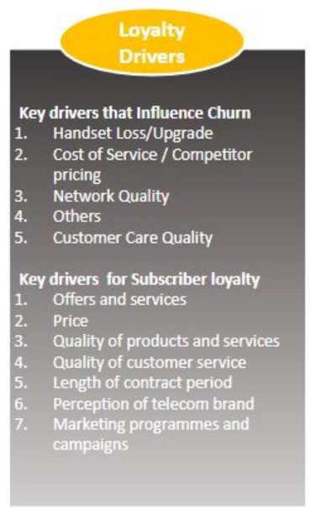
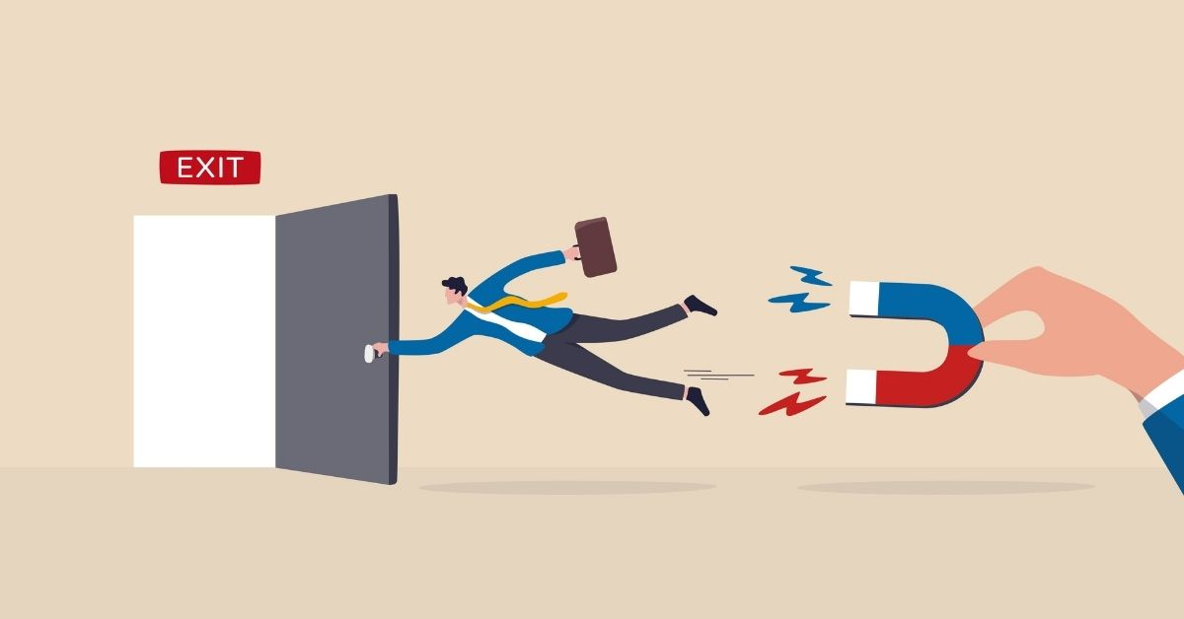
CONCLUSION
LOYALTY DRIVERS AND CUSTOMER RETENTION IDEAS
Churn rate is an important indicator for subscription-based companies. Identifying customers who aren’t happy can help managers identify product or pricing plan weak points, operation issues, as well as customer preferences and expectations. Once known, it’s easier to introduce proactive ways of reducing churn.

